Slide 1
KEYLOGGERS AND SECURITY
CAPSTONE PROJECT
Presented By:
Fathima Safrin A -VV College of Engineering-
Computer Science and Engineering

Slide 2
OUTLINE
Problem Statement (Should not include solution)
Proposed System/Solution
System Development Approach (Technology Used)
Algorithm & Deployment
Result (Output Image)
Conclusion
Future Scope
References

Slide 3
PROBLEM STATEMENT
In today's digital age, where cybersecurity threats loom large, one of the significant concerns is the proliferation of keyloggers, stealthy software tools designed to monitor and record keystrokes on a user's computer without their knowledge. Keyloggers pose a severe threat to individuals and organizations as they can capture sensitive information such as passwords, credit card details, and other personal data, leading to identity theft, financial loss, and privacy breaches.

Slide 4
PROPOSED SOLUTION
Certainly! A keylogger and security system could be developed using a systematic approach involving data collection, preprocessing, machine learning algorithm implementation, deployment, and evaluation. Here's a proposed outline for each step:
Data Collection:
Gather a diverse dataset of keystroke data, including timestamps, keypresses, and any contextual information available (e.g., application being used, user session).
Ensure the dataset covers various typing patterns, languages, and user behaviors to make the system robust and adaptable.
Data Preprocessing:
Clean the collected data to remove any noise or inconsistencies.Extract relevant features from the keystroke data, such as key press duration, intervals between key presses, key combinations, etc.
Normalize or scale the features to ensure consistency across different users and devices.
Machine Learning Algorithm:
Choose an appropriate machine learning algorithm(s) for the task. This could be a classification algorithm to classify keystrokes as legitimate or suspicious.
Train the algorithm using the preprocessed data. Consider techniques like cross-validation to evaluate the model's performance and fine-tune hyperparameters.
Deployment:
Develop a user-friendly interface for the keylogger and security system.
Integrate the machine learning model into the system, ensuring efficient performance and low latency.
Evaluation:
Conduct thorough testing of the deployed system under various scenarios, including normal usage and simulated attacks.
Measure the accuracy, precision, recall, and other relevant metrics to assess the system's performance.
Result:

Slide 5
SYSTEM APPROACH
The "System Approach" section outlines the overall strategy and methodology for developing and implementing keylogger and security. Here's a suggested structure for this section:
System requirements
Python IDLE
Library required to build the model
pynput
json

Slide 6
ALGORITHM & DEPLOYMENT
Certainly, let's focus specifically on the algorithm selection, data input, training process, and prediction process for a keylogger and security system:
Algorithm Selection:
Choose a suitable algorithm based on the requirements of the keylogger and security system. Common options include:
□Support Vector Machines (SVM): Effective for binary classification tasks like distinguishing between legitimate and suspicious keystrokes.
Random Forest: Robust and suitable for handling high-dimensional data with noisy features.
Hidden Markov Models (HMMs): Suitable for modeling sequential data and detecting anomalies in patterns.
Data Input:
Collect keystroke data from users, including timestamped key presses and any contextual information available (e.g., application in use).
Preprocess the data to extract relevant features, such as key press duration, interval between key presses, and key combinations.
Training Process:
Split the preprocessed data into training and validation sets.
Train the selected algorithm on the training data, using techniques like cross-validation to optimize hyperparameters and prevent overfitting.
Evaluate the algorithm's performance on the validation set, adjusting parameters as necessary.
Prediction Process:
Once the algorithm is trained and validated, deploy it in the keylogger and security system.
As users type, capture their keystrokes and feed them into the deployed algorithm.
Use the trained model to predict whether the keystrokes are legitimate or suspicious based on the learned patterns.

Slide 7
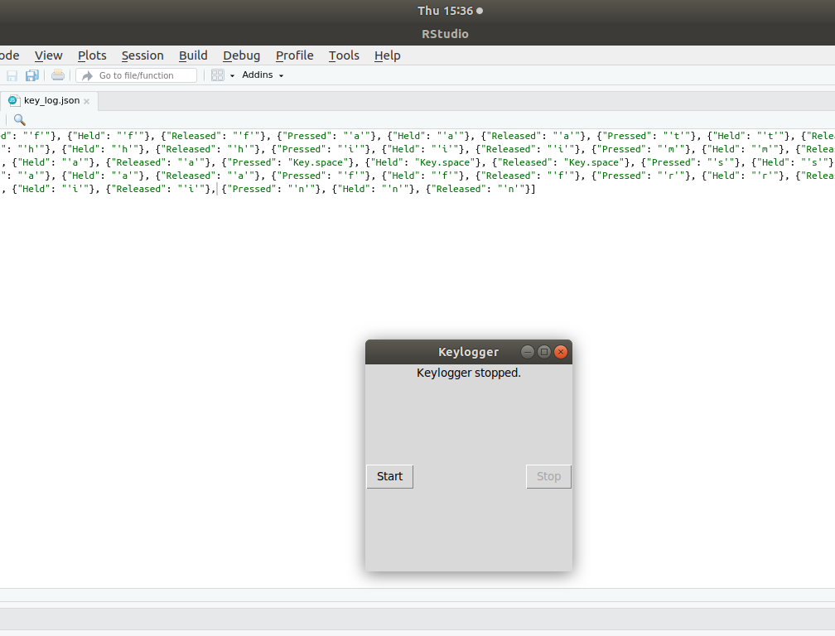
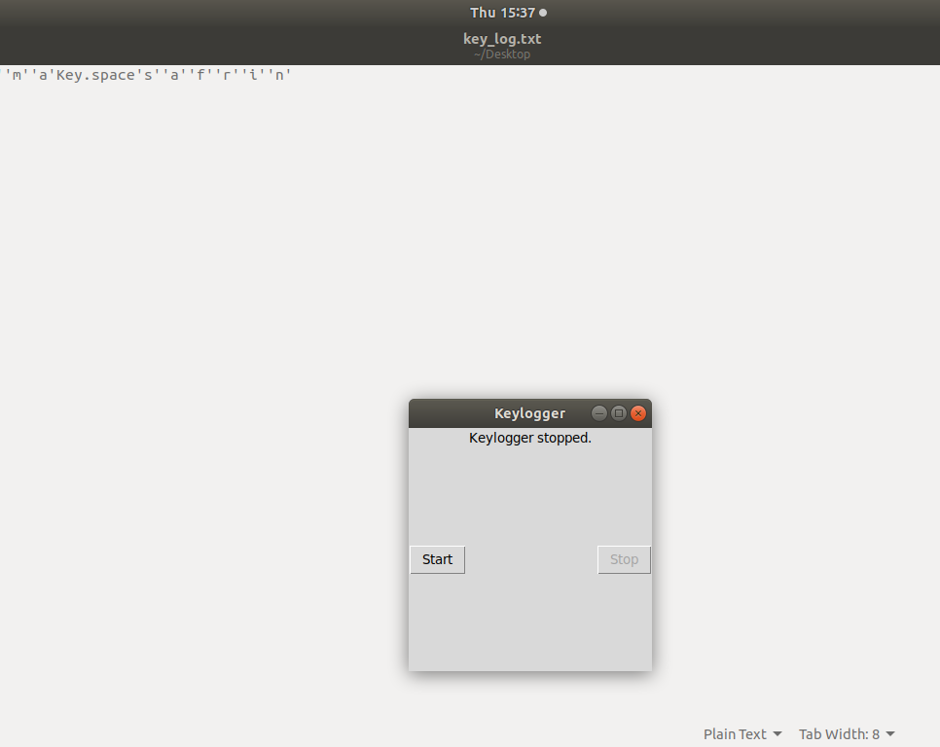
RESULT

Slide 8
CONCLUSION
Keyloggers are a potent threat to both individuals and enterprises, with the potential to cause significant harm if left undetected. Understanding the nature of keyloggers, their methods of infiltration, and the dangers they pose is crucial for maintaining a secure digital environment.

Slide 9
FUTURE SCOPE
A keylogger or keystroke logger/keyboard capturing is a form of malware or hardware that keeps track of and records your keystrokes as you type. It takes the information and sends it to a hacker using a command-and-control (C&C) server.

Slide 10
REFERENCES
"Keylogger Detection Using Machine Learning Techniques" by Yuming Zhang, Jianwei Niu, and Shuai Li
"Enhancing Computer Security against Keyloggers" by Quynh Nguyen and Madhusudan Singh
"Machine Learning-Based Keylogger Detection System" by Ashraf El-Sisi and Eslam Gamal
"A Survey of Keylogger Detection and Prevention Techniques" by T. Kavitha and N. Balakumar
"Security Issues and Solutions in Computer Systems: A Review" by Samer Samarah and Muneer Bani Yassein

Slide 11
THANK YOU

